Slide 1

Smoke-Free Homes Network Malaysia
Brain storming session on
“Growing the Network”
Welcome!
myfamily.mysmoke
https://smokefreehomes.stir.ac.uk/myfaily-mysmoke/

Slide 2
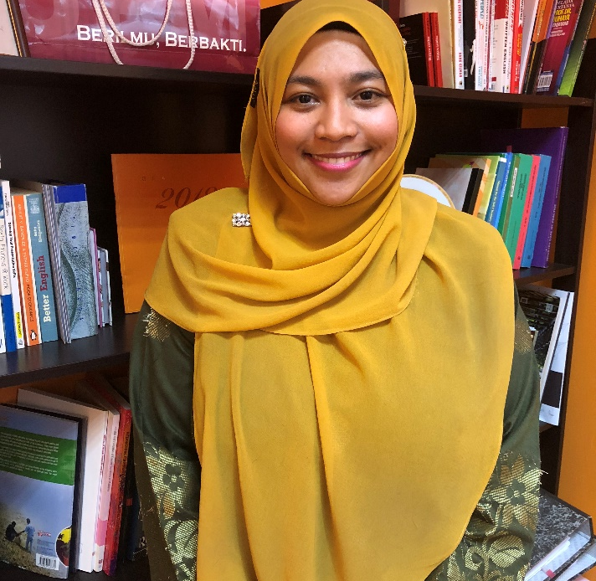
Who I am
Dr Emilia Abidin
Department of Environmental and Occupational Health
Faculty of Medicine and Health Sciences
Universiti Putra Malaysia
Email: za_emilia@upm.edu.my
Mobile number: 013-3042644
Interests: Exposure assessment, tobacco control, air pollution, OSH Management System and biomarker

Slide 3
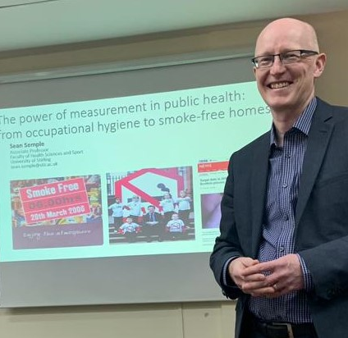
PI for MyFamily MySmoke Project
AP Dr Sean Semple
University of Stirling, United Kingdom
Email: sean.semple@stir.ac.uk
Interests: measuring exposure to hazards; tobacco control; using exposure information to change behaviour
Smoke-free homes work for 15 years

Slide 4
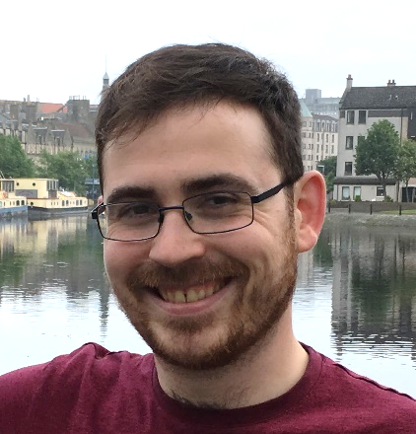
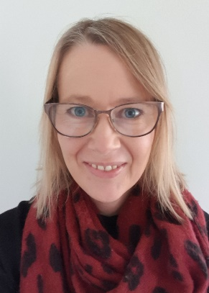
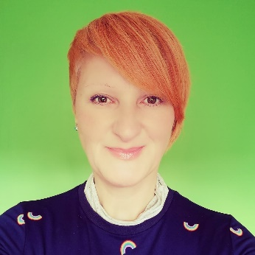
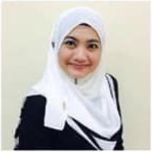
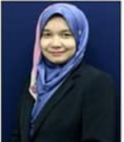
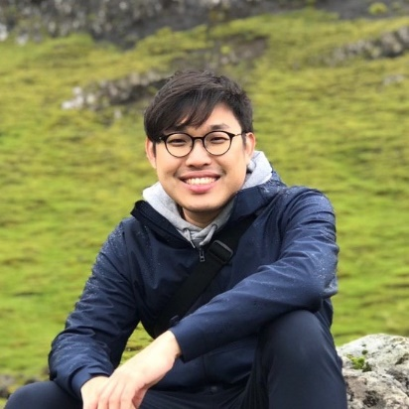

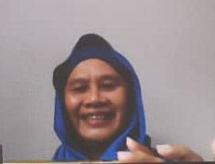
Project Members
Dr Ruaraidh Dobson
Dr Rachel O’Donnell
Dr Isabelle Uny
Dr Norul Hernani Latif
Dr Tengku Azmina Ibrahim
Ho Rhu Yann
M Sha’ani Abdullah
Roslizawati Md Ali

Slide 5
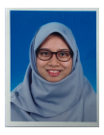
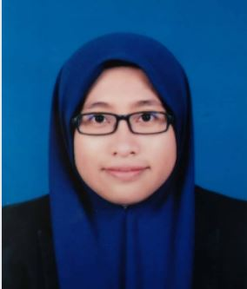
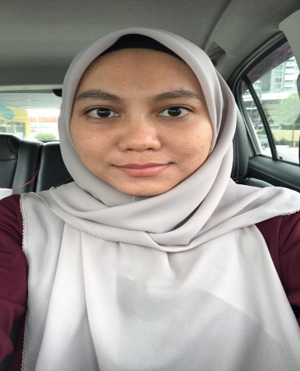
Project Members
Dr Nurul Latiffah
Dr Aziemah Zulkifli
Raisya Syazmeen

Slide 6
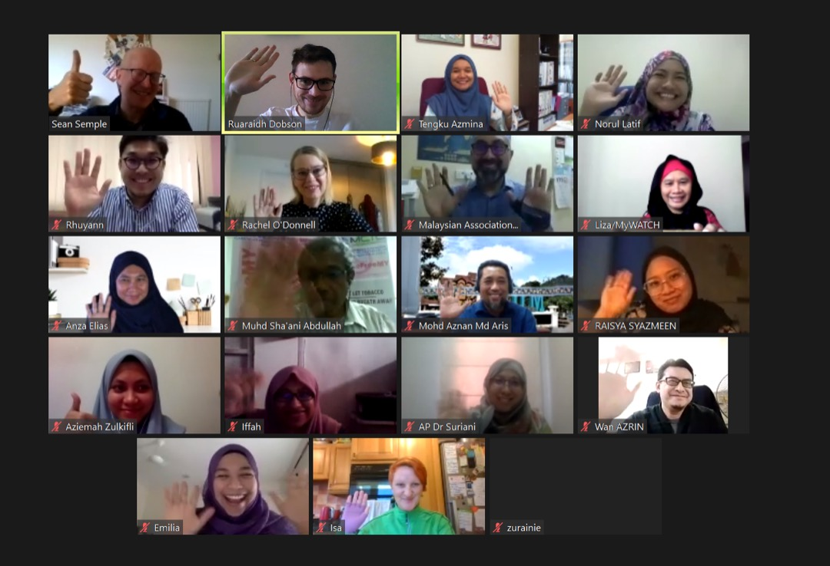
Smoke-Free Home Network Members

Slide 7
Meeting Agenda
Welcome, and updates on MFMS project – Emilia (10 minutes)
Self-introductory session on MFMS and new members – Norul Hernani (15 minutes)
Briefing on concept of network and format of meeting – Sean (5 minutes)
Discussion in breakout rooms covering on the theme of “Growing the Network” using visual maps– Led by Sean, Emilia, Norul, Rachel, Isa and Ruaraidh (20 minutes)
Break– 5 minutes
Presentation by groups– Led by Azmina (25 minutes)
Summary of the points obtained in discussion –Sean (5 minutes)
Closing remarks – Emilia (5 minutes)

Slide 8
Updates on MFMS Project
Emilia Zainal Abidin

Slide 9

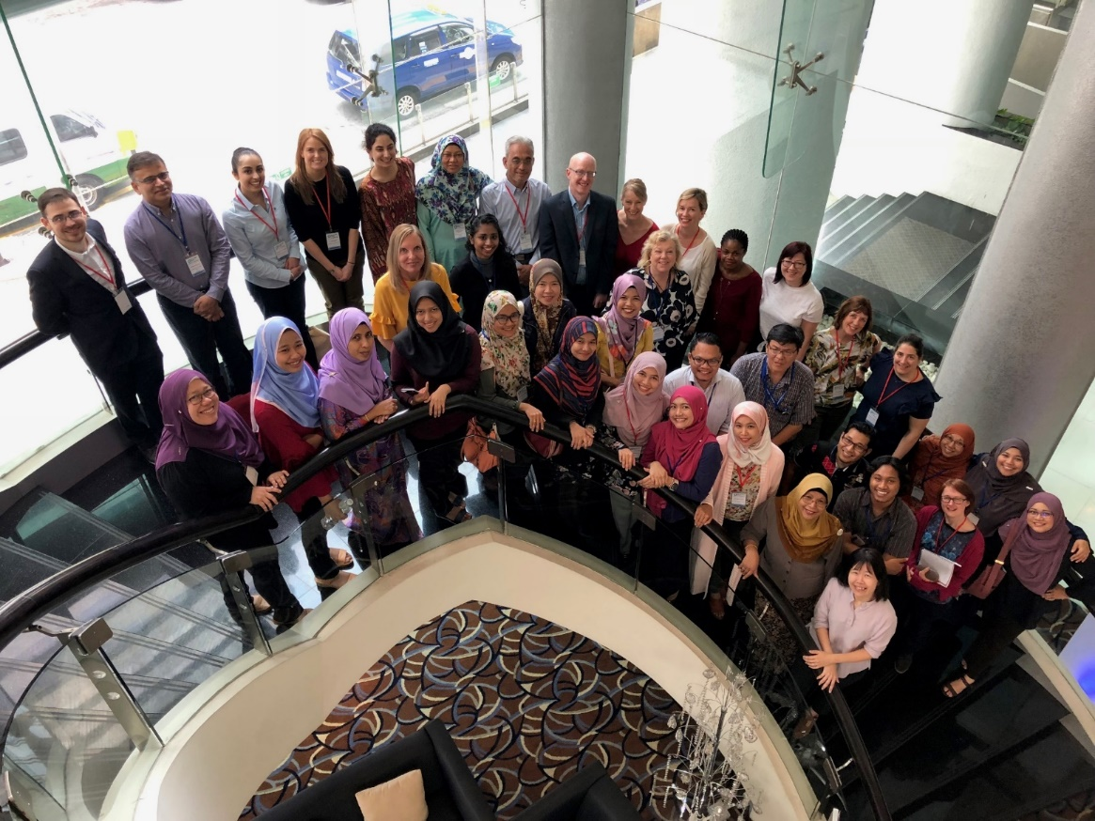
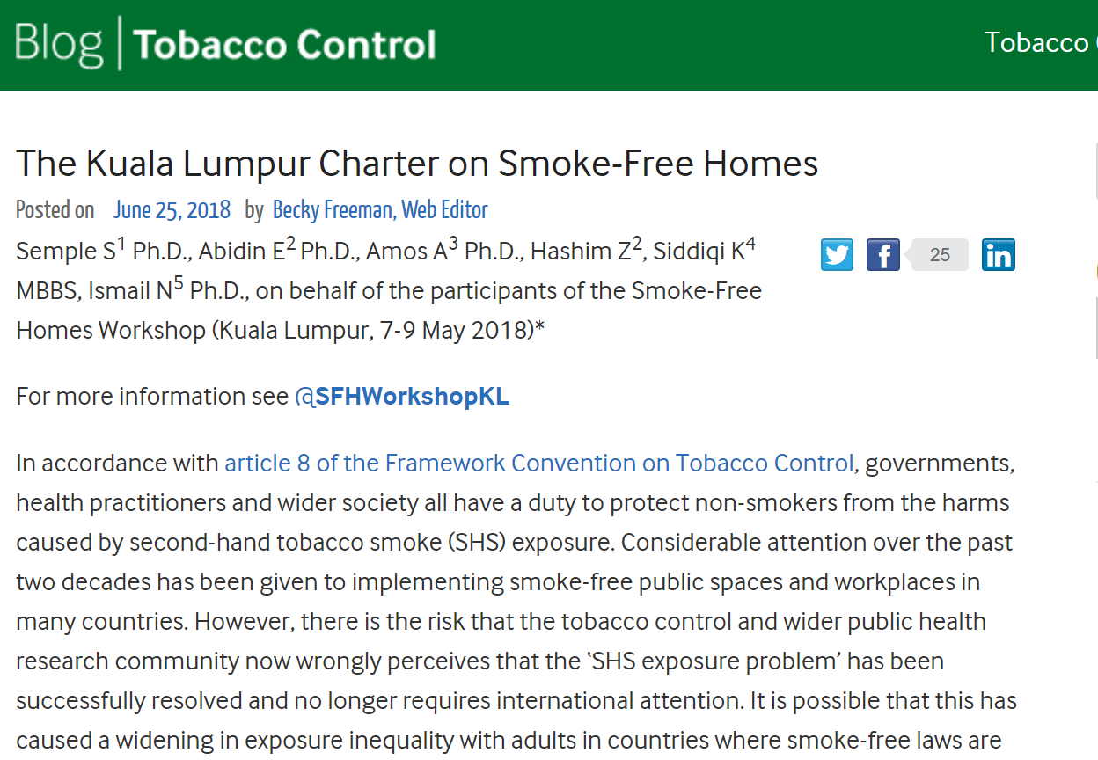
How it started?

Slide 10
Proposal to Newton Fund Impact Scheme
MyFamily MySmoke: Protecting My Family From Second-hand Smoke: Let’s Get It Right Outside.
Using measurement to create a media campaign around the benefits of a smoke-free home
Three university partners in Malaysia: UPM, IIUM and UMT and led by University of Stirling
Three NGOs partners in Malaysia – MyWatch, FOMCA and MGLA
Submitted 04 September 2019 (18 months duration)
Awarded March 2020
Started 01 May 2020

Slide 11

Planned workpackages
WP1: collect qualitative data to increase our understanding of smoking in the home in Malaysia. Who smokes, when, where and why?

Slide 12
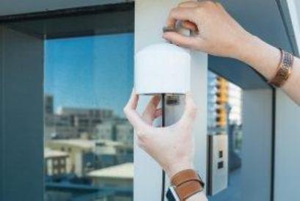
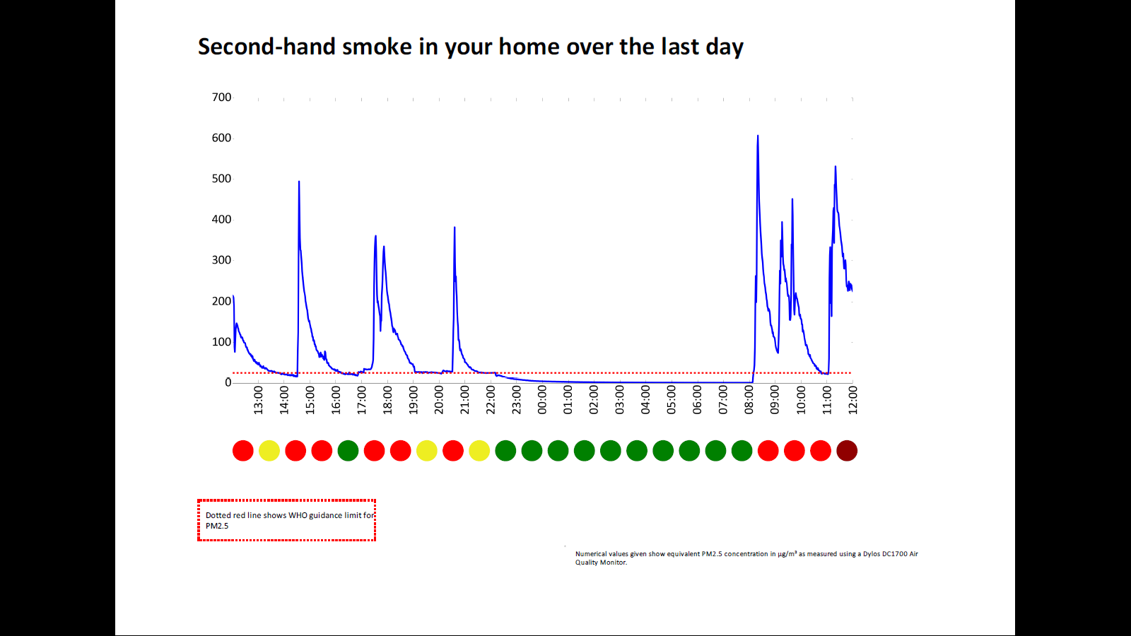
Planned workpackages
WP2: develop case studies to show the journey of people who protect their families from SHS
  campaign of media engagement with Malaysian based NGOs using real-life examples

Slide 13

Planned workpackages
WP3: establish a Malaysian Smoke-Free Homes network of academics, policymakers and NGOs to develop capacity.

Slide 14

Current Progress
WP1
Across each centres:
UPM – 18 participants recruited
IIUM – 8 participants recruited
UMT- 12 participants recruited
Transcribing and translating in progress

Slide 15
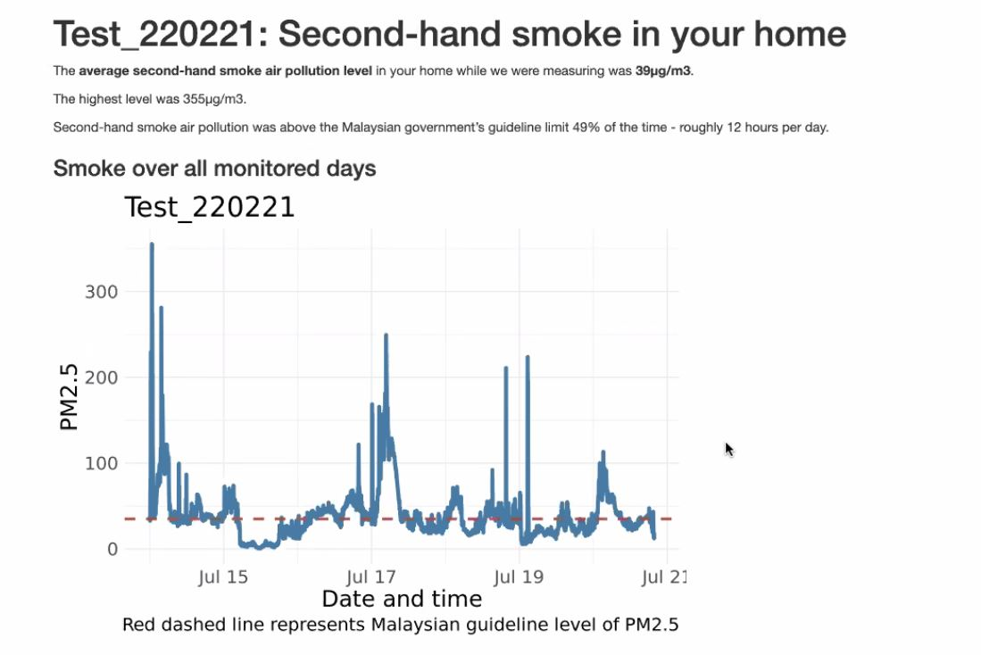
Current Progress
WP2
Across each centres:
UPM – 4 household measured
IIUM – 3 household measured
UMT – 2 household measured
Results in progress

Slide 16
Timetable

Slide 17
Thank You!
This work was supported by a Newton Fund Impact Scheme grant, ID 534474856, under the Newton-Ungku Omar Fund partnership. The grant is funded by the UK Department for Business, Energy and Industrial Strategy and MIGHT and delivered by the British Council. For further information, please visit www.newtonfund.ac.uk.

