Slide 1
Smoke-Free Homes Network Malaysia Sandpit Event Welcome
AP Dr Sean Semple and AP Dr Emilia Zainal Abidin
and the big team of MyFamilyMySmoke Project

Slide 2
Meeting rules
Please mute yourself unless you wish to speak
Use the chat function to indicate you have a question or raise your hand
We hope we can leave the video function switched on but if audio becomes poor we may switch videos off

Slide 3
MyFamily MySmoke co-PI
Dr Sean Semple
University of Stirling
Email: sean.semple@stir.ac.uk
Interests: measuring exposure to hazards; tobacco control; using exposure information to change behaviour
Smoke-free homes work for 15 years

Slide 4
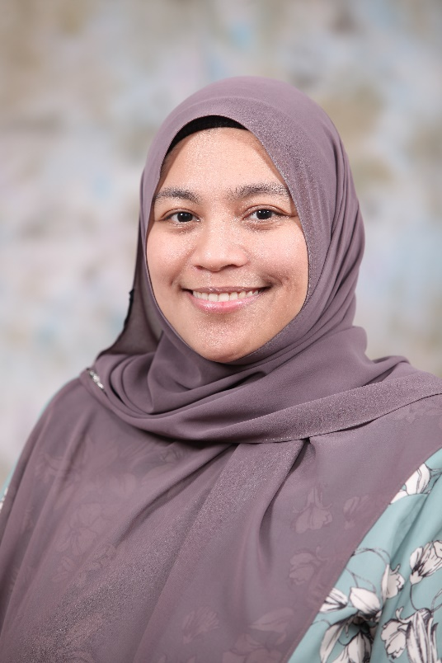
MyFamily MySmoke co-PI
Emilia Abidin, Ph.D
Universiti Putra Malaysia
Email: za_emilia@upm.edu.my
emiliazainal@gmail.com
013-3042644
Interests: Exposure assessment in air quality, biomarker in secondhand smoke exposure and tobacco control

Slide 5
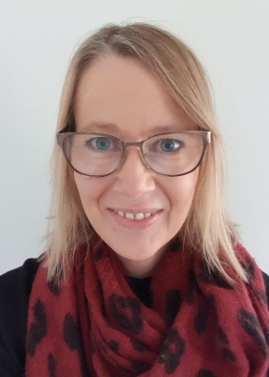
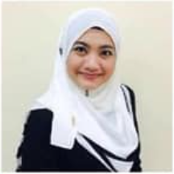
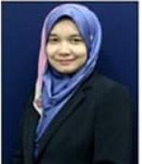
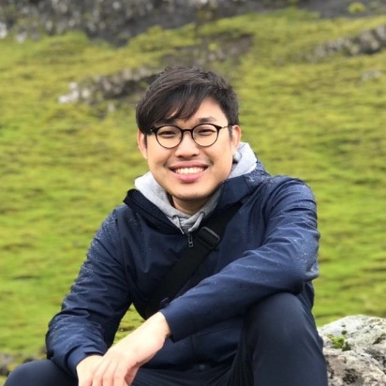
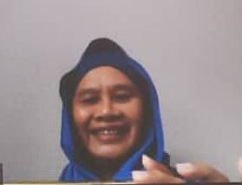
Other members
Dr Ruaraidh Dobson
Dr Rachel O’Donnell
Dr Isabelle Uny
Dr Norul Hernani Latif
Dr Tengku Azmina Ibrahim
Ho Rhu Yann
M Sha’ani Abdullah
Roslizawati Md Ali

Slide 6
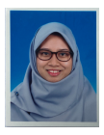
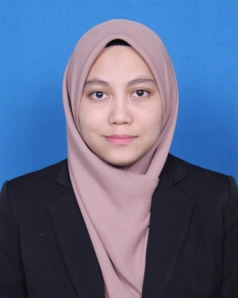
Other members
Dr Nurul Latiffah
Dr Aziemah Zulkifli
Raisya Syazmeen

Slide 7
Our Sandpit
Where to next?
Looking to combine our ideas to find ways to work with each other at the end of the current grant.
Notes:
Smoke-free homes research in Malaysia – where to next?
Looking for opportunities for funding/research and ways of working with each other at the end of the current Newton/MIGHT project period (December 2021)

Slide 8
Meeting Agenda
Welcome, introduction on the aims of sandpit event – Sean (10 minutes)
Updates on MFMS project – Emilia (10 minutes)
Briefing on format of meeting – Sean (5 minutes)
Discussion in breakout rooms covering on the theme of “Smoke-free homes research in Malaysia – Where to next?” (60 minutes)
Break – 15 minutes
Presentation on summary from each breakout room representative – (20 minutes)
2-minute idea pitching session by participants with 5 minutes discussion (20 minutes)
Summary of the list of research ideas to pursue – Sean (5 minutes)
Closing remarks – Emilia (5 minutes)

Slide 9
MyFamily MySmoke 3rd Quartile Project Updates
Dr Emilia Zainal Abidin

Slide 10
Proposal to Newton Fund Impact Scheme
MyFamily MySmoke: Protecting My Family From Second-hand Smoke: Let’s Get It Right Outside.
Using measurement to create a media campaign around the benefits of a smoke-free home
Three university partners in Malaysia
Three NGOs partners in Malaysia
Started 01 May 2020 and will end 30 November 2021

Slide 11
Planned Work Packages: How Far Have We Gone ?
WP1: collect qualitative data via interview to understand issues related to smoking in the home in Malaysia
WP 1 progress | UPM, UMT and IIUM (n)
Subjects Interviewed | 48
Male smokers | 33
Male and Female non-smoker | 15
B40 | 26
Notes:
experiences and views related to being a man and a father [or grandfather/uncle] who smokes.
role as a [insert father, grandfather, uncle as appropriate] in creating and maintaining a smoke-free home
Changes to smoking behaviours in the home over time, and as a function of
becoming/being a father OR raising children within the family home
Household negotiations
In this section, we will explore areas including:
o decision making about smoking restrictions/measures – who makes the decisions and why, how are any smoke-free rules made
o If applicable, views on being asked to smoke outdoors by others
6. Children’s perceptions of father’s smoking behaviour
o Whether children are aware of their father’s smoking, reactions and experiences.
o How interviewees feel about this in their role as a father
7. How best to support fathers/families in their efforts to be smoke-free at home

Slide 12
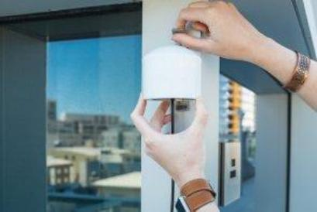
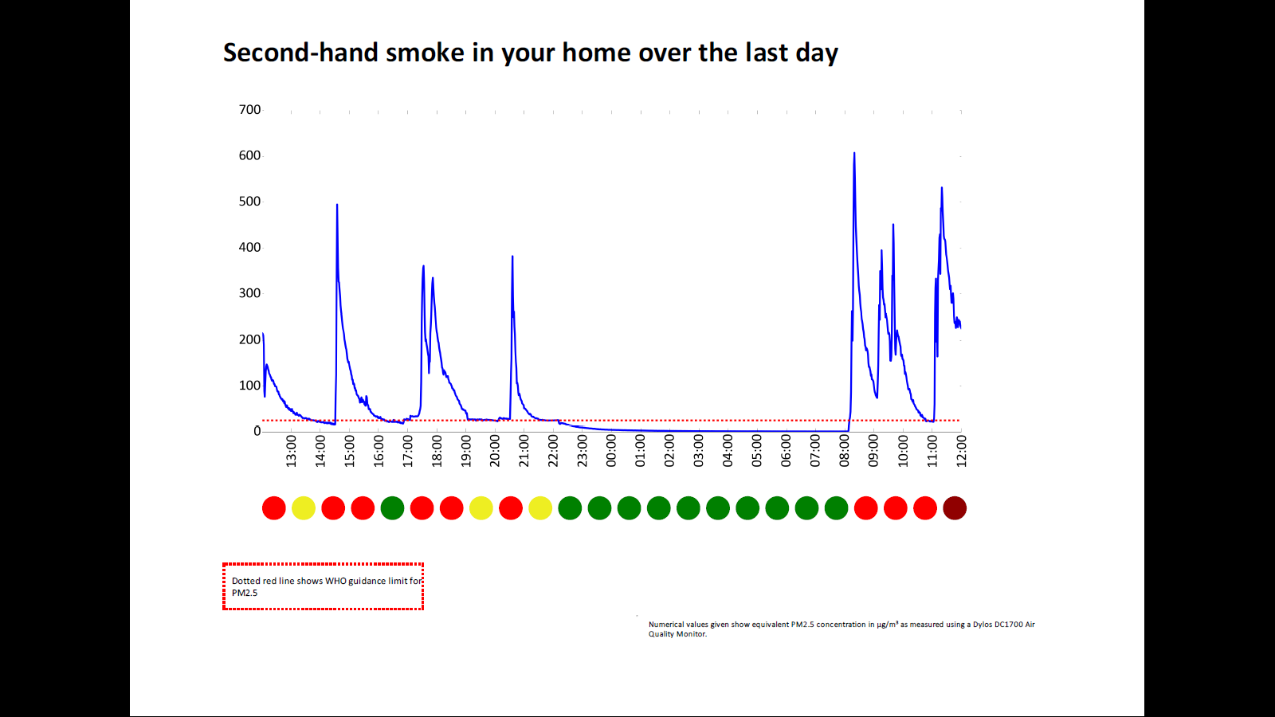
Planned Workpackages
WP2: collect PM2.5 levels and provide personalised feedbacks to participants

Slide 13
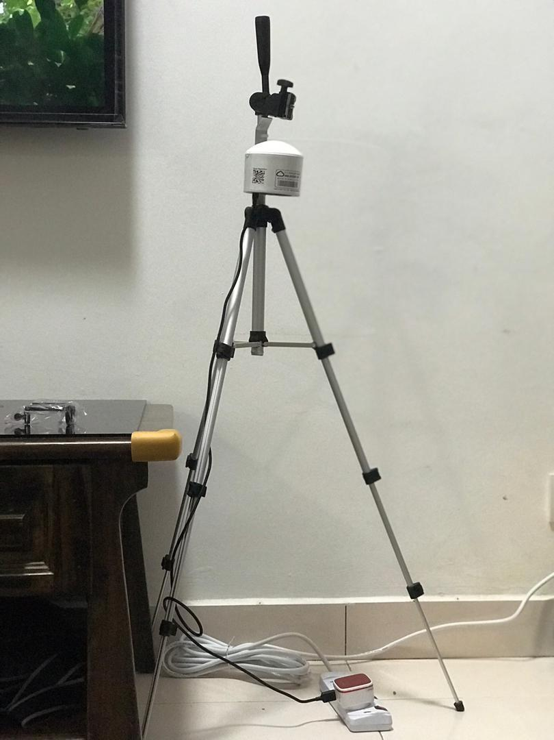
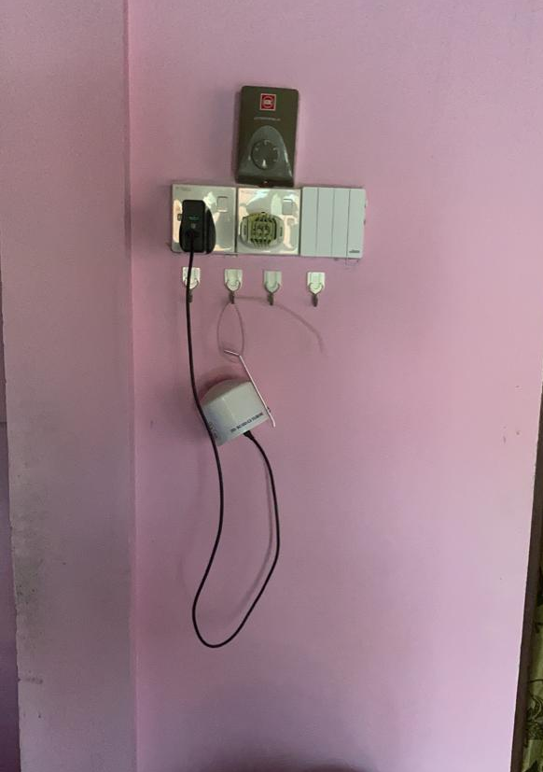
Figure 1 & 2 : Installation of Purple Air in the respondents’ house

Slide 14
How Far Have We Gone?
WP 2 progress | UPM, UMT and IIUM (n)
Baseline measurement completed | 15/30
Feedback delivery | 13/30
2nd phase measurement completed | 13/30

Slide 15
Actual Example of PM2.5 Levels from SHS
Heavy smoker (>20 cigarettes per day)
Smoked in the house; mostly in the living room
Living with a wife and three children; youngest 3 years old
Youngest child had eczema; besides other factors, respondent suspected that his children health condition might be due to his smoking habit in the house
Example of PM2.5 measurements for 1 average day in a participant’s home
PM2.5 (µg/m³)
24-hour Malaysian Air Quality Standards of 35ug/m3
Time and date
The aim of this graph is to provide scientific evidence to show that their indoor smoking habit give significant impact to their indoor PM2.5 levels

Slide 16
The Final Gap in Our Work
Producing Media Campaigns
Develop case studies to show real-life journey of people who protect their families from SHS
The need to have platform to park our media campaigns via engagements with Malaysian-based NGOs
Any suggestions and thoughts are welcomed!

Slide 17
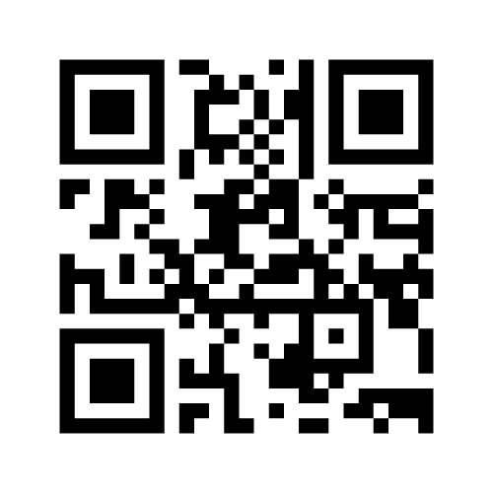
Mentimeter Engagement Session
Using your phones, go to https://www.menti.com/ and key in the code 1 1 1 0 3 0 5 5 and click submit
Please identify your organisation and What three words describe your work?
We will generate speech bubbles and word map of the results on the screen

Slide 18
Group Allocations
Group A – Emilia, Madam Liza, Isa, Prof Mohd Aznan, Raisya, Dr Roshanim Koris
Group B – Sean, Aziemah, Mr Sha’ani, Dr Zurainie, Prof Hassim, Prof Amer
Group C – Norul, Prof Haniki, Ruaraidh, Iffah, Dr Wency, Prof Fredie
Group D – Rachel, AP Dr. Norashidah, AP Dr. Suriani, Mr Subbarow, Azmina, Ikmal

Slide 19
Questions to discuss in 4 breakout sessions
Quick introductions – get to know who is in your room
What research would you like to do or see on SFHs in the next year or two?
Or if you work in policy or practice do you have an opportunity to work with researchers on SHS?
News/idea or upcoming activity in 2021/22 (including potential funding)
Use the ‘jamboard’ to enter your thoughts if possible
Feel free to write in English or Malay – whatever is easiest for you
The jamboard will remain open after the meeting

Slide 20
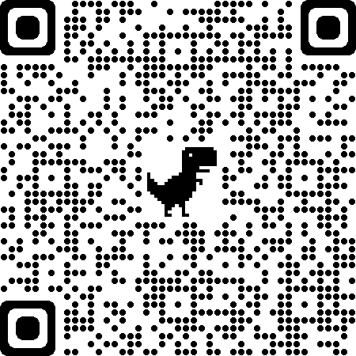
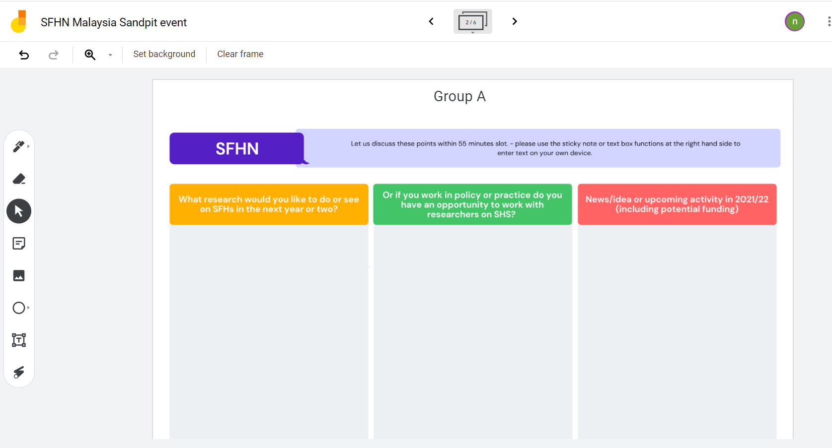
The Jamboard and QR Code
https://jamboard.google.com/d/187vNUIbexbnAIVD47jHndZN4_y20fr3sdGvqWxvNLJk/viewer?f=0
Menu bar for text box or sticky note

Slide 21
Thank You! And let us take a group photo before we start…
This work was supported by a Newton Fund Impact Scheme grant, ID 534474856, under the Newton-Ungku Omar Fund partnership. The grant is funded by the UK Department for Business, Energy and Industrial Strategy and MIGHT and delivered by the British Council. For further information, please visit www.newtonfund.ac.uk.

Slide 22
Mentimeter Engagement Session
Using your phones, go to https://www.menti.com/ and key in the code 1 1 1 0 3 0 5 5 and click submit
We will generate the results of the poll on the screen.

Slide 23
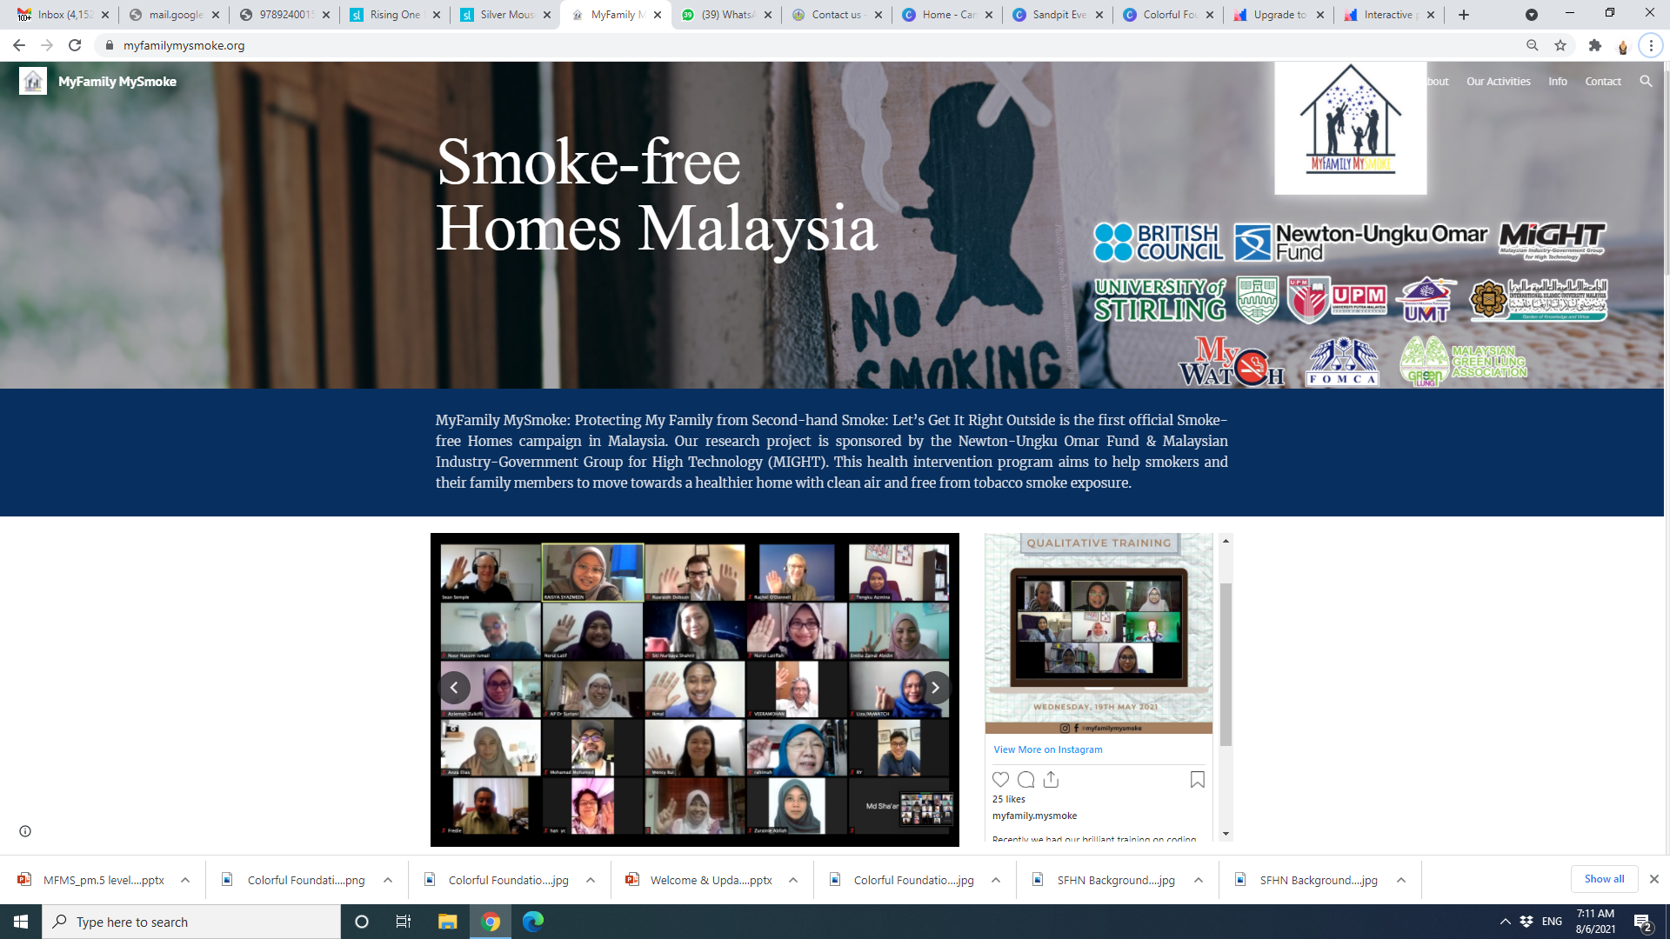
Follow us on our social media and we can be reached via our FB page and webpage

Slide 24
Thank You!
This work was supported by a Newton Fund Impact Scheme grant, ID 534474856, under the Newton-Ungku Omar Fund partnership. The grant is funded by the UK Department for Business, Energy and Industrial Strategy and MIGHT and delivered by the British Council. For further information, please visit www.newtonfund.ac.uk.

